Slide 1
Performance Analysis of Brain Tumor Detection Using Different Neural Networks Models
Final Presentation

Slide 2
Team Members
NAMES 700#
MADDIKUNTA DAKSHYANI 700666204
SWETHA BANDARI 700740708
AKHILESH CHENNABATNI MANDULA 700759335
GOVARDHANI UPPALURI 700739664

Slide 3
Roles and Responsibilities
Data Collection and Augmentation: xxxx
Responsibilities:
Gathered a dataset of Brain MRI Images from Kaggle.
Conducted data augmentation techniques to increase dataset diversity.
Contribution:
Ensured the availability of a diverse and augmented dataset essential for training and evaluating the neural network models.
VGG Model Training: xxxx
Responsibilities:
Implemented and trained the VGG neural network model for brain tumor detection.
Tuned hyperparameters and optimized the VGG architecture for improved performance.
Contribution:
Achieved a high accuracy rate of 95.7% with the VGG model, demonstrating expertise in model training and optimization.

Slide 4
LeNet Model Training: xxxx
Responsibilities:
Developed and trained the LeNet neural network model for brain tumor detection.
Fine-tuned model parameters and evaluated performance metrics.
Contribution:
Obtained a respectable accuracy rate of 82.58% with the LeNet model, showcasing proficiency in neural network training and evaluation.
CNN Model Training: xxxxxx
Responsibilities:
Implemented and trained the CNN neural network model for brain tumor detection.
Conducted rigorous experimentation and analyzed model performance.
Contribution:
Achieved a moderate accuracy rate of 78.71% with the CNN model, demonstrating expertise in model development and evaluation.

Slide 5
Motivation
The motivation behind our project lies in the critical need for precise and efficient brain tumor detection methods. Current manual interpretation of MRI images is labor-intensive, subjective, and prone to errors, hindering timely diagnosis and treatment planning. Leveraging deep learning and neural network models, our project aims to automate this process, offering a reliable solution for accurate tumor detection. By harnessing the power of advanced computational techniques, we seek to revolutionize clinical practice by providing radiologists with effective tools for early detection and intervention. Additionally, our project contributes to medical research by uncovering insights into tumor characteristics and behavior, potentially leading to breakthroughs in neuro-oncology. Ultimately, our efforts are driven by the desire to improve patient outcomes, enhance diagnostic accuracy, and advance the field of brain tumor detection and treatment.

Slide 6
Objectives Of Our Project
Evaluate the performance of different neural network architectures, including convolutional neural networks (CNNs) for brain tumor detection using MRI scans.
Compare the accuracy, sensitivity, specificity, and computational efficiency of various neural network models in detecting both common and rare types of brain tumors.
Investigate the impact of dataset size, diversity, and preprocessing techniques on the performance of neural network models for brain tumor detection.
Assess the robustness and generalization capabilities of neural network models across different patient populations and imaging protocols.
Explore the feasibility of integrating automated brain tumor detection systems into clinical workflows and evaluate their potential impact on diagnostic accuracy and efficiency.
Provide insights and recommendations for optimizing neural network architectures, hyperparameters, and training procedures to enhance the performance of automated brain tumor detection systems.
Identify challenges and limitations in current approaches to brain tumor detection using neural network models and propose directions for future research and development in the field.

Slide 7
Related Work
1. Zhang et al. (2020): "Performance Evaluation of Deep Learning Models for Brain Tumor Detection and Segmentation" : This study evaluates various deep learning models for brain tumor detection and segmentation, comparing their accuracy and computational efficiency on MRI datasets.
2. Chen et al. (2020): "Multi-Modal Brain Tumor Segmentation Using 3D Deep Neural Networks" : Chen et al. propose a 3D deep neural network architecture for multi-modal brain tumor segmentation from MRI scans, achieving improved segmentation accuracy compared to 2D methods.
3. Wang et al. (2021): "Automated Brain Tumor Detection Using Convolutional Neural Networks and Feature Fusion" : Wang et al. develop an automated brain tumor detection system based on convolutional neural networks (CNNs) and feature fusion techniques, enhancing detection accuracy by integrating complementary information from multiple sources.
4. Liu et al. (2020): "Deep Learning-Based Brain Tumor Classification Using Radiomics Features": Liu et al. utilize radiomics features extracted from MRI images for deep learning-based brain tumor classification, demonstrating the effectiveness of radiomics-based approaches in improving classification performance.

Slide 8
Problem Statement
Brain tumor detection is a critical aspect of medical imaging analysis, where accurate and timely diagnosis significantly impacts patient outcomes. However, traditional methods often suffer from limitations in terms of accuracy and efficiency. This project addresses the need for improved brain tumor detection methodologies by leveraging the capabilities of neural network models. The primary objective is to compare the performance of different neural network architectures in accurately identifying brain tumors from MRI images. By conducting a comprehensive performance analysis encompassing metrics such as accuracy, precision, recall, and ROC curves, this study aims to identify the most effective model for brain tumor detection. The findings of this research will contribute to advancing the field of medical image analysis, ultimately leading to enhanced diagnostic accuracy and better patient care in neurology and oncology.

Slide 9
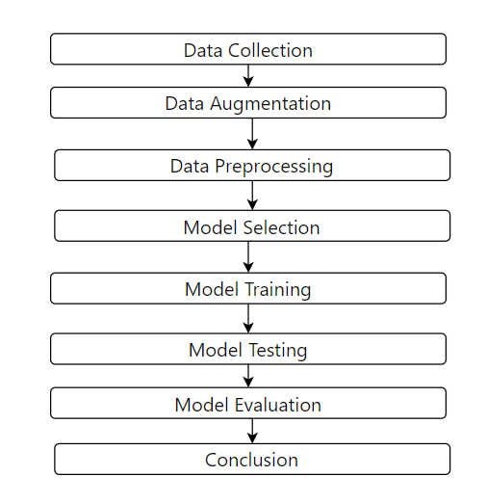
Proposed Solution
This is the framework followed to perform this project and draw conclusions.

Slide 10
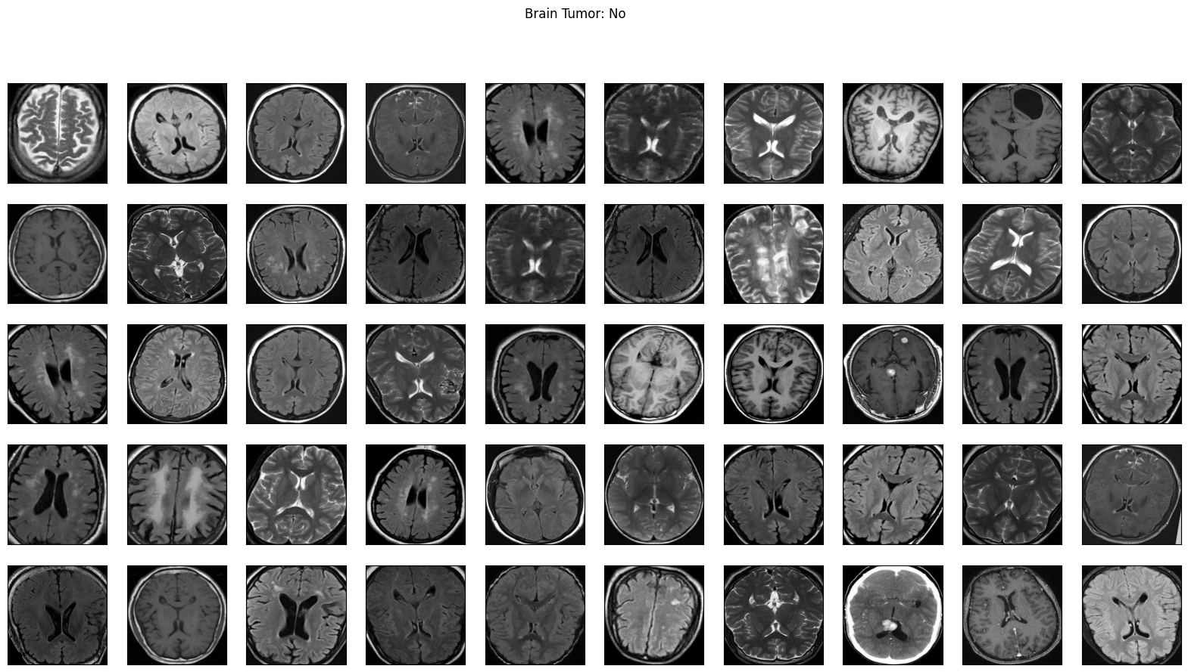
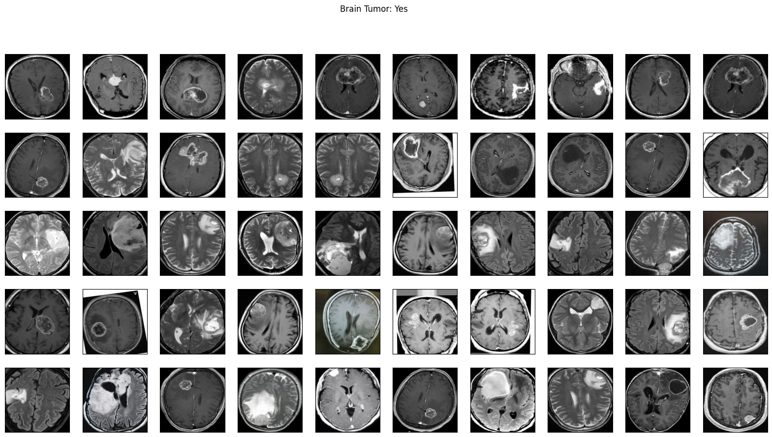
Results

Slide 11
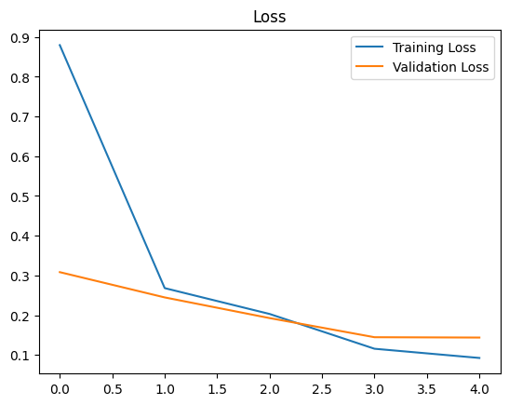
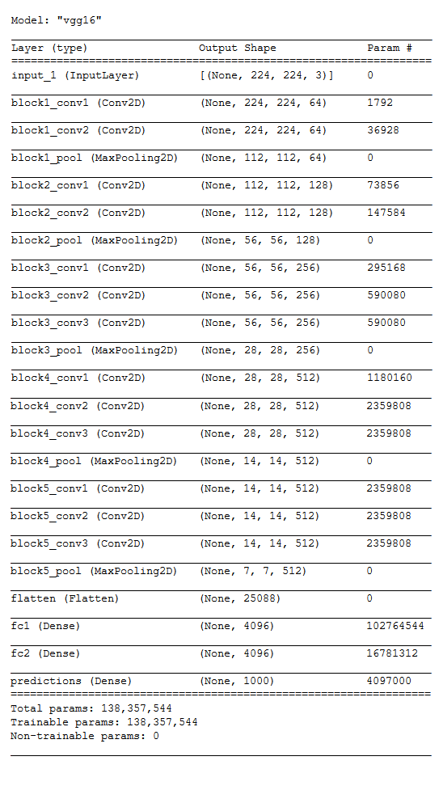
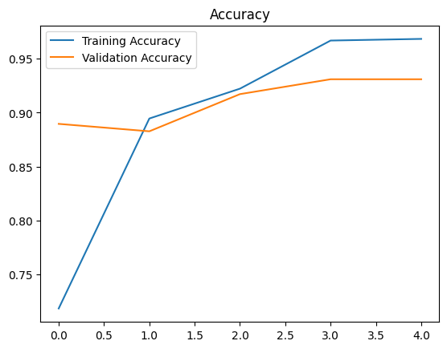
VGG MODEL

Slide 12
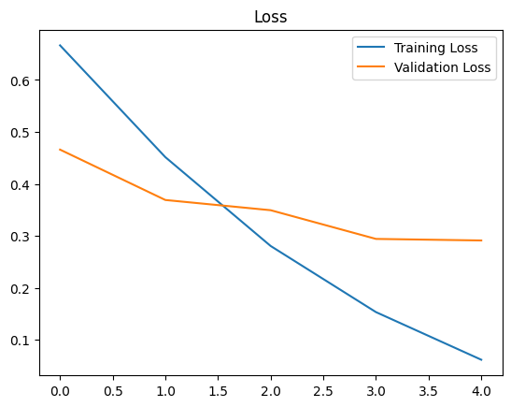
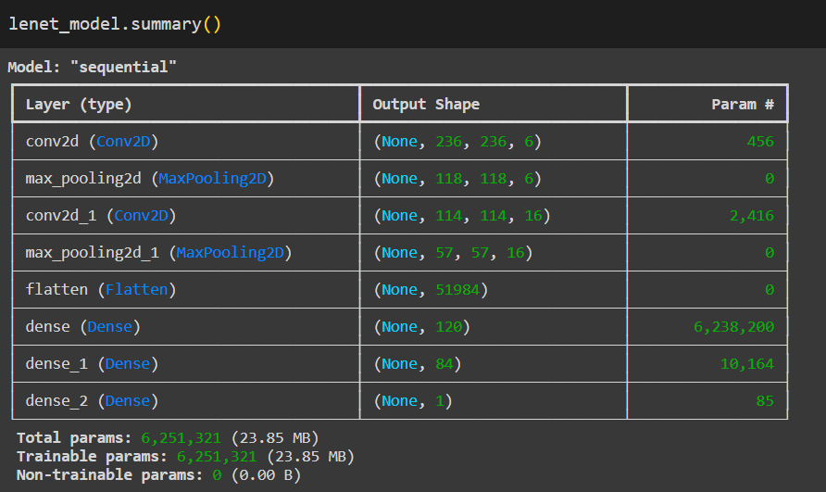
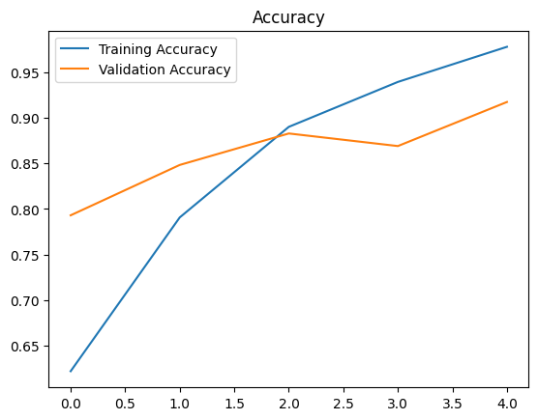
LeNet Model

Slide 13
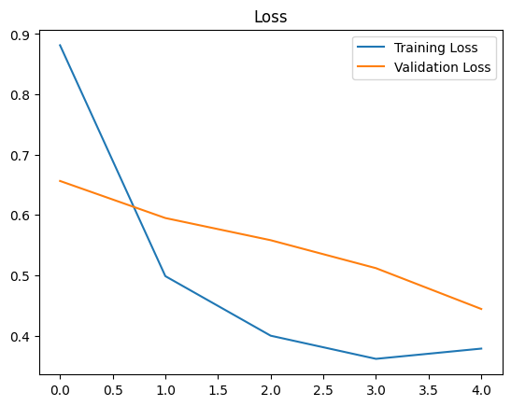
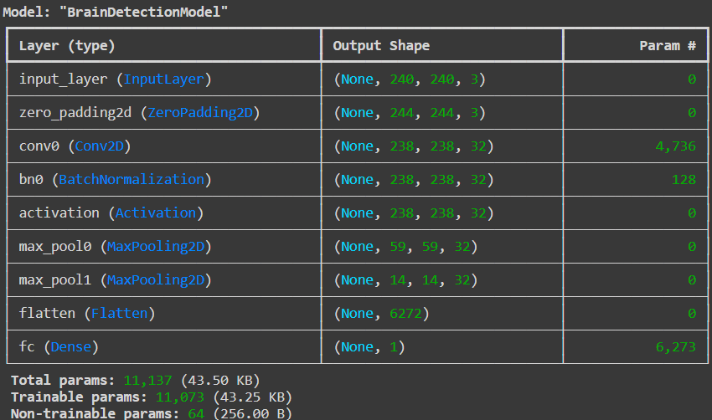
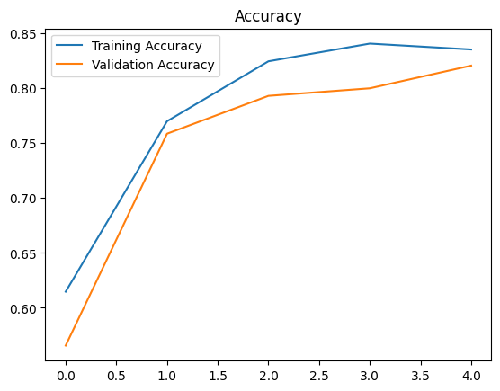
CNN Model

Slide 14
Conclusion
The VGG model(accuracy 95.7), with its deep architecture and ability to capture intricate features, proved to be highly effective in distinguishing subtle differences between tumorous and non-tumorous brain images.
The LeNet model exhibited a respectable accuracy rate of 82.58%, although it fell short of the performance achieved by the VGG model.
The CNN model yielded a moderate accuracy rate of 74.5%, which was lower than both VGG and LeNet.
While CNNs are commonly used for image classification tasks, the lower accuracy observed in our study suggests that the specific architecture and parameters of the CNN model may not have been optimized for optimal performance in brain tumor detection.

Slide 15
Thank You

